Slide 1
Phase Field Modeling of Thin Film Ferroelectrics

Slide 2
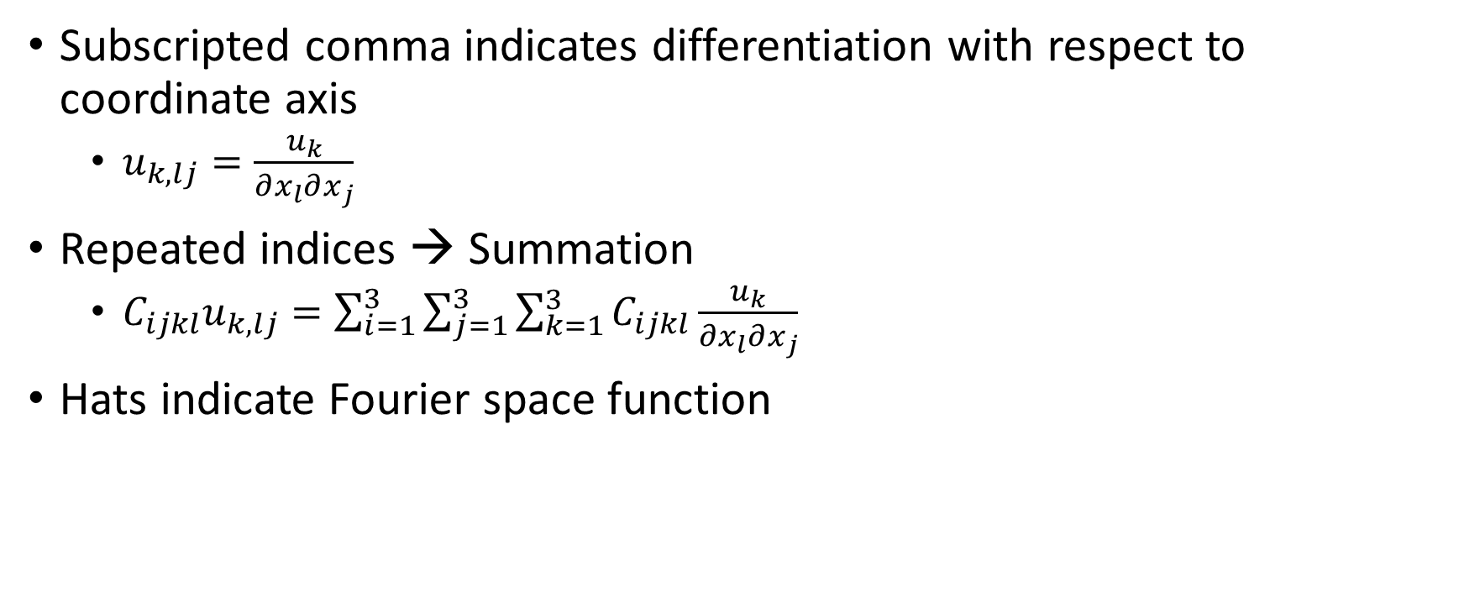
Notation
Subscripted comma indicates differentiation with respect to coordinate axis
$u_{k,lj}=\frac{u_{k}}{∂x_{l}∂x_{j}}$
Repeated indices → Summation
$C_{ijkl}u_{k,lj}=\sum_{i=1}^{3}{\sum_{j=1}^{3}{\sum_{k=1}^{3}{C_{ijkl}\frac{u_{k}}{∂x_{l}∂x_{j}}}}}$
Hats indicate Fourier space function

Slide 3
Phase Field Model
Minimization of free energy
Energy Terms:
Landau
…

Slide 4
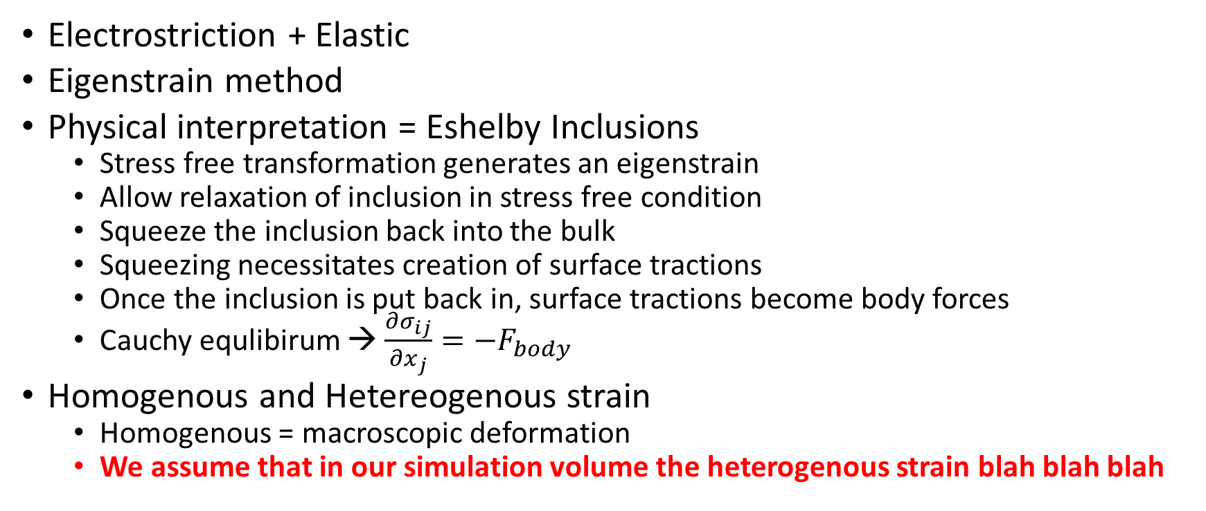
Elastic Energy
Electrostriction + Elastic
Eigenstrain method
Physical interpretation = Eshelby Inclusions
Stress free transformation generates an eigenstrain
Allow relaxation of inclusion in stress free condition
Squeeze the inclusion back into the bulk
Squeezing necessitates creation of surface tractions
Once the inclusion is put back in, surface tractions become body forces
Cauchy equlibirum → $\frac{∂σ_{ij}}{∂x_{j}}=−F_{body}$
Homogenous and Hetereogenous strain
Homogenous = macroscopic deformation
We assume that in our simulation volume the heterogenous strain blah blah blah

Slide 5

Eshelby Inclusions
${\overline{σ}}_{ij}=C_{ijkl}{\overline{ε}}_{kl}$
${σ_{ij}\left(\vec{r}\right)=\overline{σ}}_{ij}+δσ_{ij}\left(\vec{r}\right)$
${δσ}_{ij}=C_{ijkl}\left(δε_{kl}−ε_{kl}^{0}\right)=C_{ijkl}\left(u_{k,l}−ε_{kl}^{0}\right)$
${ε_{ij}\left(\vec{r}\right)=\overline{ε}}_{ij}+δε_{ij}\left(\vec{r}\right)$
$δε_{ij}=\frac{1}{2}\left(u_{i,j}+u_{j,i}\right)$

Slide 6
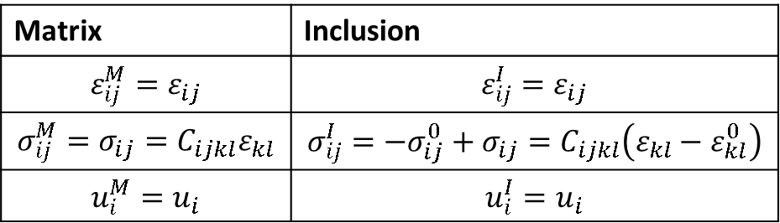
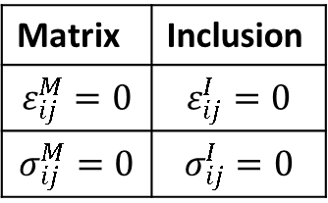
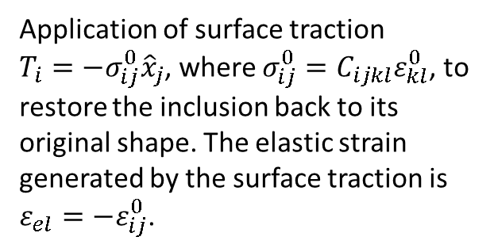
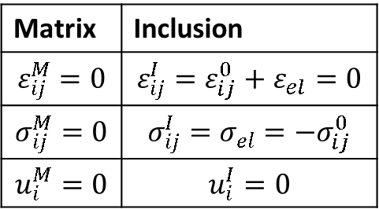
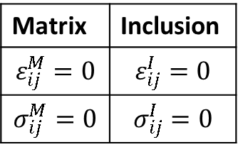
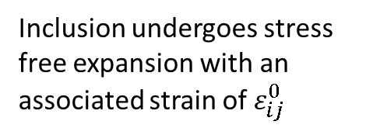
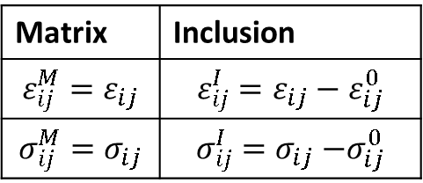
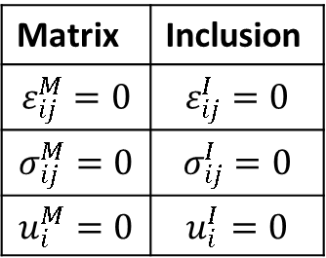
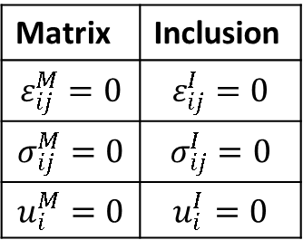
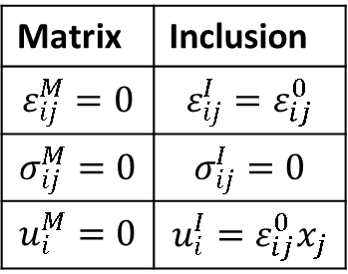
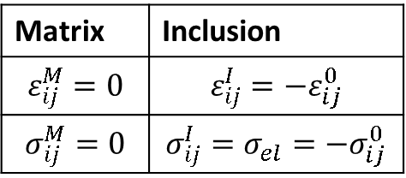

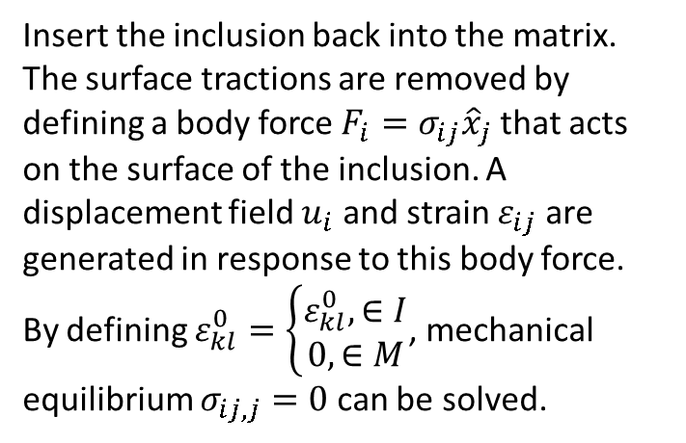

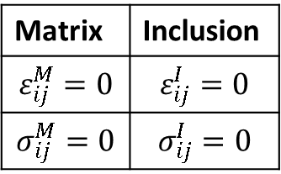
Total Stress and Strain
Elastic Stress and Strain
Matrix
1.
Matrix | Inclusion
$$ε_{ij}^{M}=0$$ | $$ε_{ij}^{I}=0$$
$$σ_{ij}^{M}=0$$ | $$σ_{ij}^{I}=0$$
$$u_{i}^{M}=0$$ | $$u_{i}^{I}=0$$
Matrix | Inclusion
$$ε_{ij}^{M}=0$$ | $$ε_{ij}^{I}=0$$
$$σ_{ij}^{M}=0$$ | $$σ_{ij}^{I}=0$$
No elastic strains exist in the material
Inclusion
2.
Matrix | Inclusion
$$ε_{ij}^{M}=0$$ | $$ε_{ij}^{I}=0$$
$$σ_{ij}^{M}=0$$ | $$σ_{ij}^{I}=0$$
$$u_{i}^{M}=0$$ | $$u_{i}^{I}=0$$
Matrix | Inclusion
$$ε_{ij}^{M}=0$$ | $$ε_{ij}^{I}=0$$
$$σ_{ij}^{M}=0$$ | $$σ_{ij}^{I}=0$$
Remove inclusion from the matrix
3.
Matrix | Inclusion
$$ε_{ij}^{M}=0$$ | $$ε_{ij}^{I}=ε_{ij}^{0}$$
$$σ_{ij}^{M}=0$$ | $$σ_{ij}^{I}=0$$
$$u_{i}^{M}=0$$ | $$u_{i}^{I}=ε_{ij}^{0}x_{j}$$
Matrix | Inclusion
$$ε_{ij}^{M}=0$$ | $$ε_{ij}^{I}=0$$
$$σ_{ij}^{M}=0$$ | $$σ_{ij}^{I}=0$$
Inclusion undergoes stress free expansion with an associated strain of $ε_{ij}^{0}$
4.
$$T_{i}$$
Matrix | Inclusion
$$ε_{ij}^{M}=0$$ | $$ε_{ij}^{I}=ε_{ij}^{0}+ε_{el}=0$$
$$σ_{ij}^{M}=0$$ | $$σ_{ij}^{I}=σ_{el}={−σ}_{ij}^{0}$$
$$u_{i}^{M}=0$$ | $$u_{i}^{I}=0$$
Matrix | Inclusion
$$ε_{ij}^{M}=0$$ | $$ε_{ij}^{I}=−ε_{ij}^{0}$$
$$σ_{ij}^{M}=0$$ | $$σ_{ij}^{I}=σ_{el}={−σ}_{ij}^{0}$$
Application of surface traction ${T_{i}=−σ}_{ij}^{0}{\hat{x}}_{j}$, where $σ_{ij}^{0}=C_{ijkl}ε_{kl}^{0}$, to restore the inclusion back to its original shape. The elastic strain generated by the surface traction is $ε_{el}=−ε_{ij}^{0}$.
5.
Insert the inclusion back into the matrix. The surface tractions are removed by defining a body force ${F_{i}=σ}_{ij}{\hat{x}}_{j}$ that acts on the surface of the inclusion. A displacement field $u_{i}$ and strain $ε_{ij}$ are generated in response to this body force. By defining $ε_{kl}^{0}=\left\{\begin{matrix}ε_{kl}^{0},∈I \\ 0,∈M\end{matrix}\right.$, mechanical equilibrium $σ_{ij,j}=0$ can be solved.
$$F_{i}$$
Matrix | Inclusion
$$ε_{ij}^{M}=ε_{ij}$$ | $$ε_{ij}^{I}=ε_{ij}$$
$$σ_{ij}^{M}=σ_{ij}=C_{ijkl}ε_{kl}$$ | $$σ_{ij}^{I}={−σ}_{ij}^{0}+σ_{ij}=C_{ijkl}\left(ε_{kl}−ε_{kl}^{0}\right)$$
$$u_{i}^{M}=u_{i}$$ | $$u_{i}^{I}=u_{i}$$
Matrix | Inclusion
$$ε_{ij}^{M}=ε_{ij}$$ | $$ε_{ij}^{I}=ε_{ij}−ε_{ij}^{0}$$
$$σ_{ij}^{M}=σ_{ij}$$ | $$σ_{ij}^{I}=σ_{ij}{−σ}_{ij}^{0}$$

Slide 7
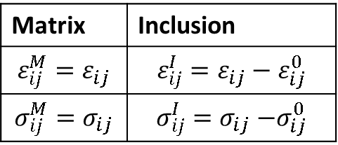
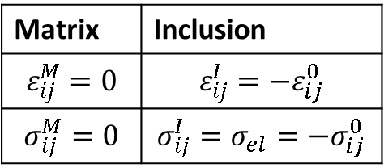
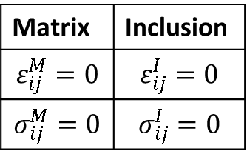
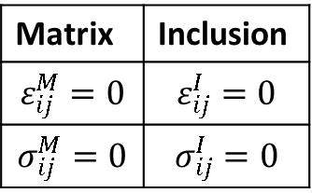
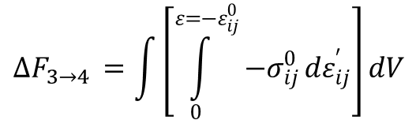

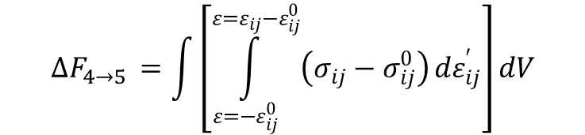
Matrix
Elastic Stress and Strain
1.
Matrix | Inclusion
$$ε_{ij}^{M}=0$$ | $$ε_{ij}^{I}=0$$
$$σ_{ij}^{M}=0$$ | $$σ_{ij}^{I}=0$$
Inclusion
2.
Matrix | Inclusion
$$ε_{ij}^{M}=0$$ | $$ε_{ij}^{I}=0$$
$$σ_{ij}^{M}=0$$ | $$σ_{ij}^{I}=0$$
3.
Matrix | Inclusion
$$ε_{ij}^{M}=0$$ | $$ε_{ij}^{I}=0$$
$$σ_{ij}^{M}=0$$ | $$σ_{ij}^{I}=0$$
4.
$$T_{i}$$
Matrix | Inclusion
$$ε_{ij}^{M}=0$$ | $$ε_{ij}^{I}=−ε_{ij}^{0}$$
$$σ_{ij}^{M}=0$$ | $$σ_{ij}^{I}=σ_{el}={−σ}_{ij}^{0}$$
$$∆F_{3→4 }=\int{\left[\int_{0}^{ε={−ε}_{ij}^{0}}{−σ_{ij}^{0}}dε_{ij}^{′}\right]}dV$$
5.
$$F_{i}$$
Matrix | Inclusion
$$ε_{ij}^{M}=ε_{ij}$$ | $$ε_{ij}^{I}=ε_{ij}−ε_{ij}^{0}$$
$$σ_{ij}^{M}=σ_{ij}$$ | $$σ_{ij}^{I}=σ_{ij}{−σ}_{ij}^{0}$$
$$∆F_{4→5 }=\int{\left[\int_{ε=−ε_{ij}^{0}}^{ε=ε_{ij}{−ε}_{ij}^{0}}{\left(σ_{ij}−σ_{ij}^{0}\right)}dε_{ij}^{′}\right]}dV$$

Slide 8


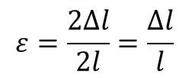



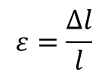

$$ε=\frac{∆l}{l}$$
$$ε=\frac{2∆l}{2l}=\frac{∆l}{l}$$
$$∆l$$
$$∆l$$
$$∆l$$
$$l$$
$$l$$
$$l$$

Slide 9

Macroscopic Thin Film Boundary Conditions
${\overline{ε }}_{11}={\overline{ε }}_{22}=U_{s}$
${\overline{ε }}_{12}=0$
${\overline{σ }}_{13}={\overline{σ }}_{23}={\overline{σ }}_{33}=0$

Slide 10
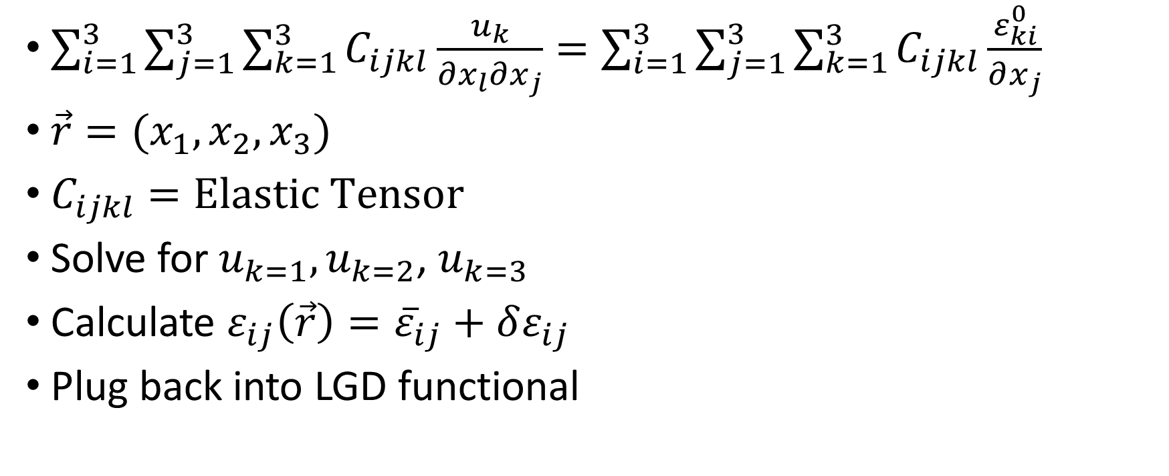
Relaxation of Heterogenous Strain
$\sum_{i=1}^{3}{\sum_{j=1}^{3}{\sum_{k=1}^{3}{C_{ijkl}\frac{u_{k}}{∂x_{l}∂x_{j}}}}}=\sum_{i=1}^{3}{\sum_{j=1}^{3}{\sum_{k=1}^{3}{C_{ijkl}\frac{ε_{ki}^{0}}{∂x_{j}}}}}$
$\vec{r}=(x_{1},x_{2},x_{3})$
$C_{ijkl}=Elastic Tensor$
Solve for $u_{k=1},u_{k=2}$, $u_{k=3}$
Calculate ${ε_{ij}\left(\vec{r}\right)=\overline{ε}}_{ij}+δε_{ij}$
Plug back into LGD functional

Slide 11
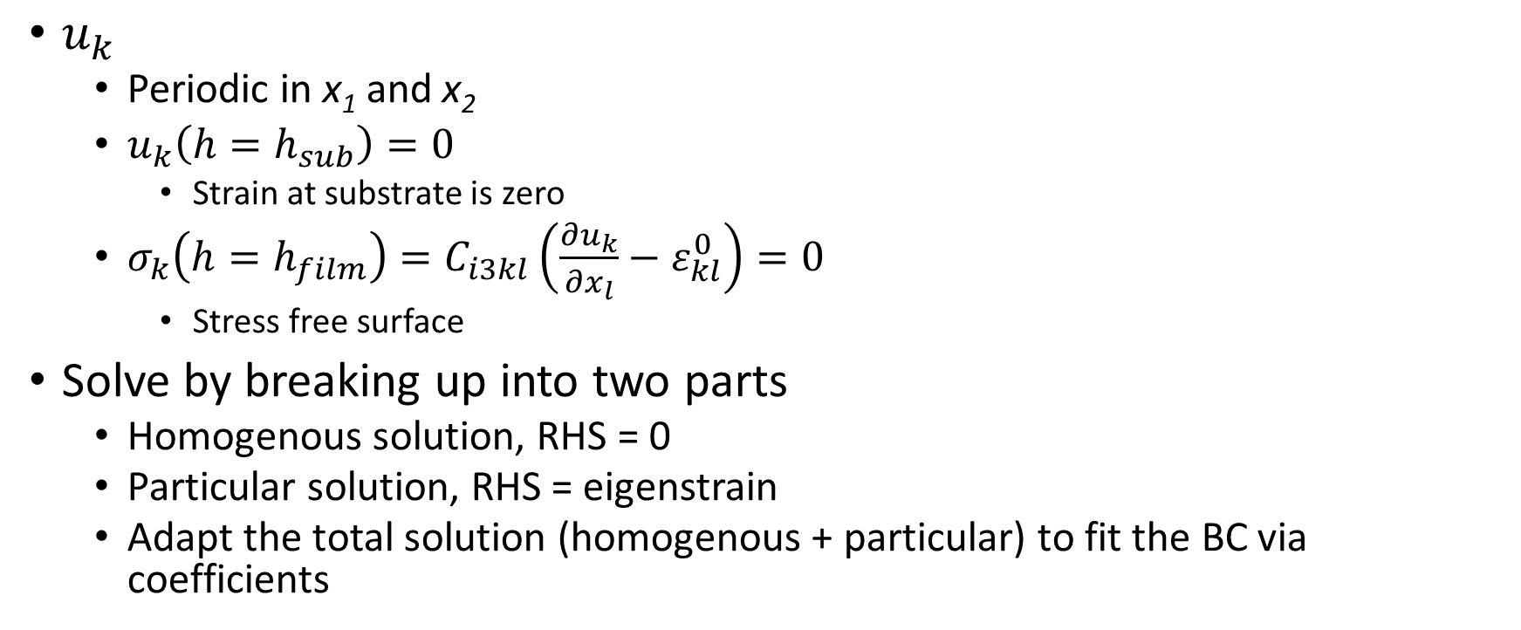
Thin Film Boundary Conditions for Heterogenous Strain
$u_{k}$
Periodic in x₁ and x₂
$u_{k}\left(h=h_{sub}\right)=0$
Strain at substrate is zero
$σ_{k}\left(h=h_{film}\right)=C_{i3kl}\left(\frac{∂u_{k}}{∂x_{l}}−ε_{kl}^{0}\right)=0$
Stress free surface
Solve by breaking up into two parts
Homogenous solution, RHS = 0
Particular solution, RHS = eigenstrain
Adapt the total solution (homogenous + particular) to fit the BC via coefficients

Slide 12







$$x_{3}$$
$$h_{air}$$
$$h_{film}$$
$$h_{interface}$$
$$x_{2}$$
$$x_{1}$$
$$h_{sub}$$

Slide 13

Particular Solution
Easily done in Fourier space
Use Green’s elastic tensor
$C_{ijkl}u_{k,lj}=C_{ijkl}ε_{ki,j}^{0}$
Fourier Transform ($\vec{r}→\vec{η}$)
$−η_{l}η_{j}C_{ijkl}{\hat{u}}_{k}(\vec{η})={iη_{j}C}_{ijkl}{\hat{ε}}_{ki}^{0}(\vec{η})$
$Ω_{ik}^{−1}\left(\vec{η}\right)=C_{ijkl}η_{l}η_{j}$
Green’s elastic tensor
Position dependent tensor in Fourier space
${−Ω}_{ik}^{−1}{\hat{u}}_{k}(\vec{η})={iη_{j}C}_{ijkl}{\hat{ε}}_{ki}^{0}(\vec{η})$
${\hat{u}}_{k}\left(\vec{η}\right)=−{iη_{j}Ω}_{ik}C_{ijkl}{\hat{ε}}_{ki}^{0}(\vec{η})$

Slide 14

Verification of Particular Solution
Expand the RHS and LHS terms… see if they equal…
$−η_{l}η_{j}C_{ijkl}{\hat{u}}_{k}(\vec{η})={iη_{j}C}_{ijkl}{\hat{ε}}_{kl}^{0}(\vec{η})$

Slide 15
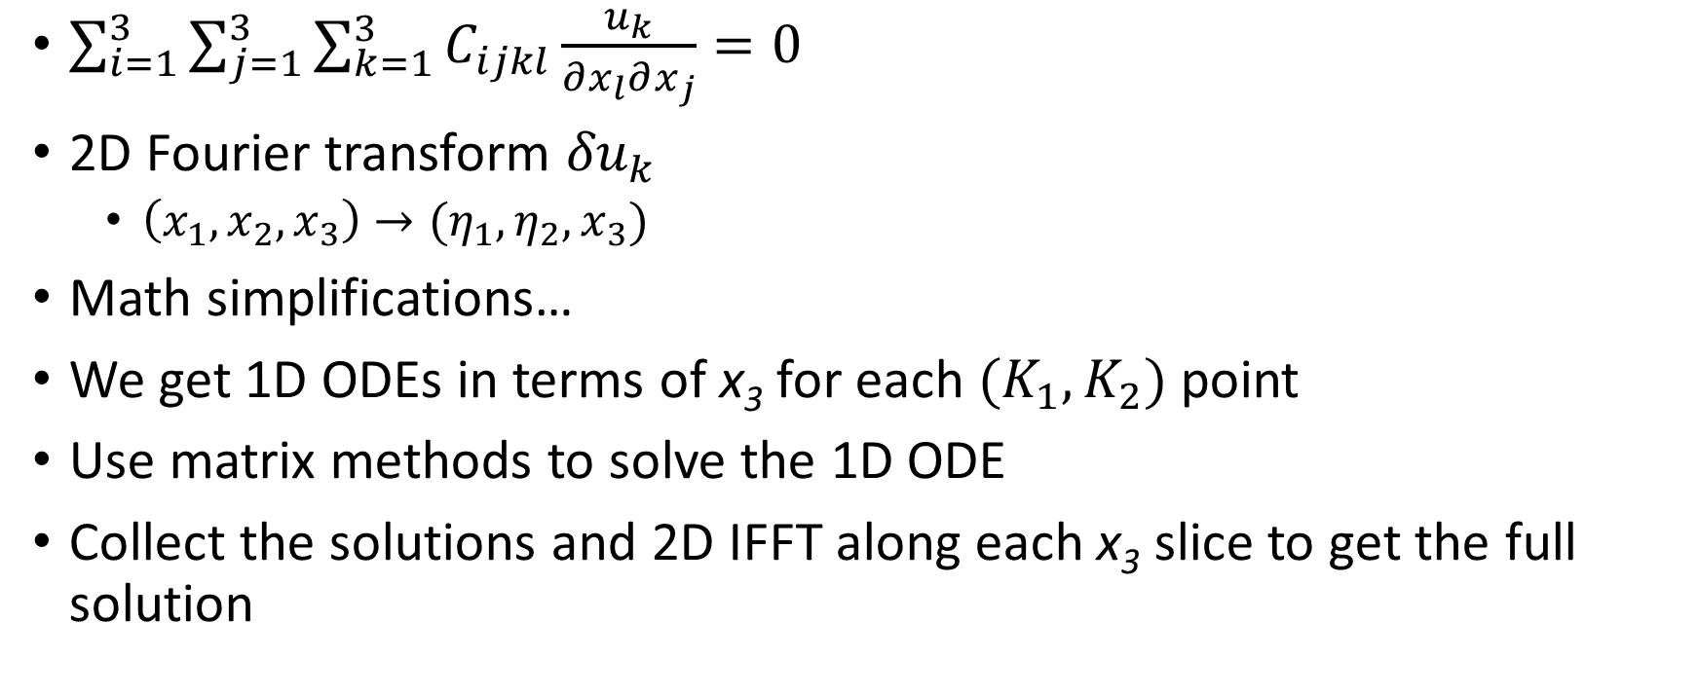
Homogenous Solution
$\sum_{i=1}^{3}{\sum_{j=1}^{3}{\sum_{k=1}^{3}{C_{ijkl}\frac{u_{k}}{∂x_{l}∂x_{j}}}}=0}$
2D Fourier transform ${δu}_{k}$
$\left(x_{1},x_{2},x_{3}\right)→(η_{1},η_{2},x_{3})$
Math simplifications…
We get 1D ODEs in terms of x₃ for each ${(K}_{1},K_{2})$ point
Use matrix methods to solve the 1D ODE
Collect the solutions and 2D IFFT along each x₃ slice to get the full solution

Slide 16
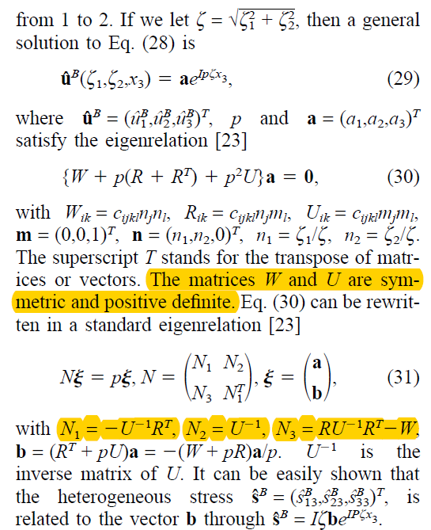

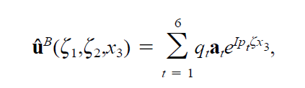
MATH… Want to solve that messy equation, guess an exponential… and we get simplifications and an eigenvalue equation…

Slide 17
The General Solution to the Homogenous Problem
Dependent on and unique to k space vector
2D Fourier Transform
General Solution
Vector: 3 components to the displacement vector
Fit coefficients to boundary conditions

Slide 18

Verification
Expand the LHS term, i = 1, 2, 3
3 Equations
i = 1 Equation:
$C44∗{\hat{u}}_{1,33}^{B}−C11∗η_{1}^{2}∗{\hat{u}}_{1}^{B}−C44∗η_{2}^{2}∗{\hat{u}}_{1,33}^{B}+η_{1}∗{\hat{u}}_{1,3}^{B}∗\left(C12∗1i+C44∗1i\right)−C12∗η_{1}∗η_{2}∗{\hat{u}}_{2}^{B}−C44∗η_{1}∗η_{2}∗{\hat{u}}_{2}^{B}=0$

Slide 19
Checking…
C11 = 27.50 * 1e10
C12 = 17.90 * 1e10
C44 = 5.43 * 1e10
64 * 64 * 64 Grid
Total length of 1 nm in x, y, and z directions
General solution, set all coefficients to zero except a few

Slide 20
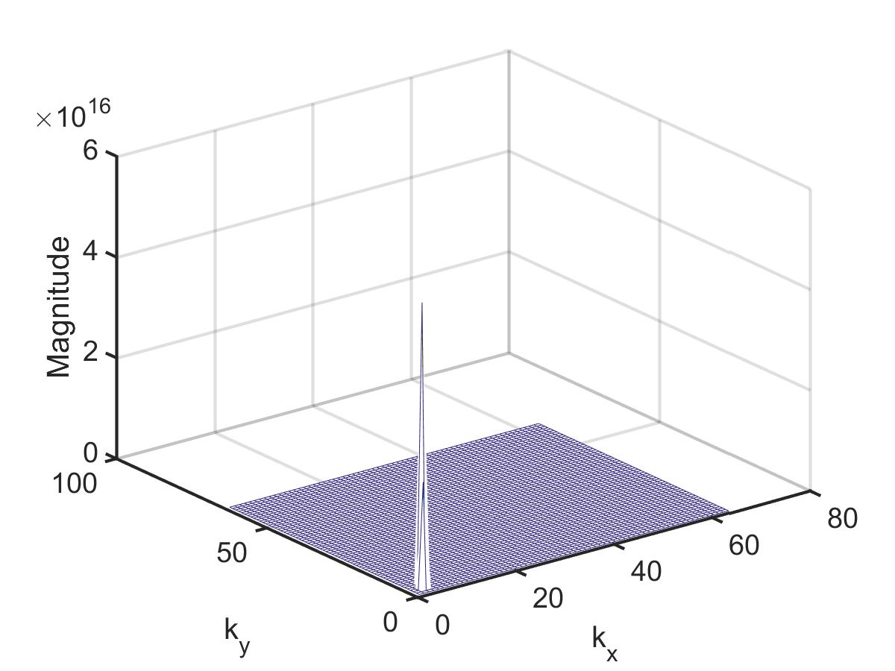
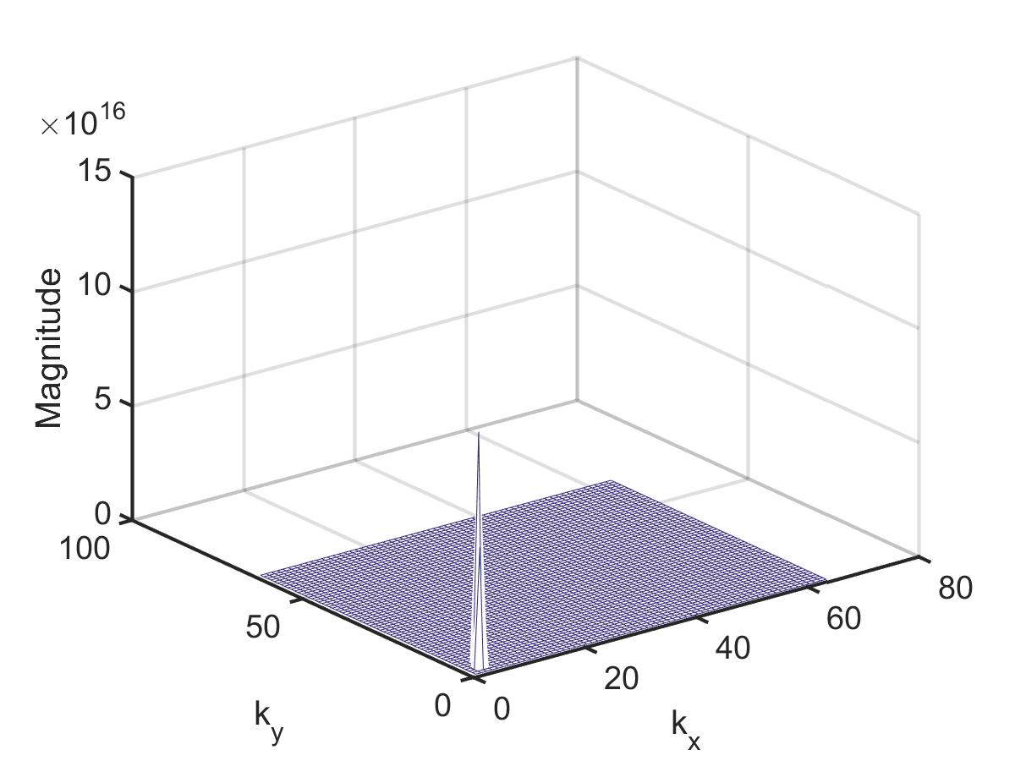
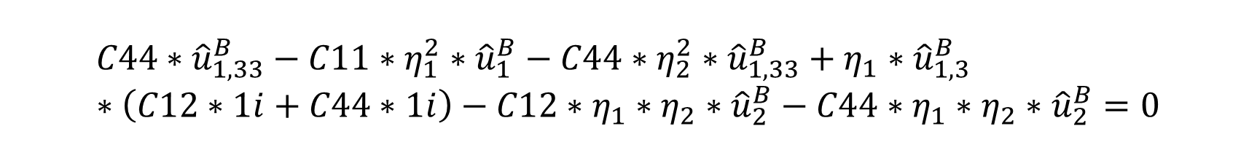


$$C44∗{\hat{u}}_{1,33}^{B}−C11∗η_{1}^{2}∗{\hat{u}}_{1}^{B}−C44∗η_{2}^{2}∗{\hat{u}}_{1,33}^{B}+η_{1}∗{\hat{u}}_{1,3}^{B}∗\left(C12∗1i+C44∗1i\right)−C12∗η_{1}∗η_{2}∗{\hat{u}}_{2}^{B}−C44∗η_{1}∗η_{2}∗{\hat{u}}_{2}^{B}=0$$
x₃ = 0
$$C44∗{\hat{u}}_{1,33}^{B}$$
x₃ = 0
$$C11∗η_{1}^{2}∗{\hat{u}}_{1}^{B}$$
What we are plotting: 2D k-space in plane, constant x₃ cross section, z axis = magnitude of the function value at that specific point

Slide 21
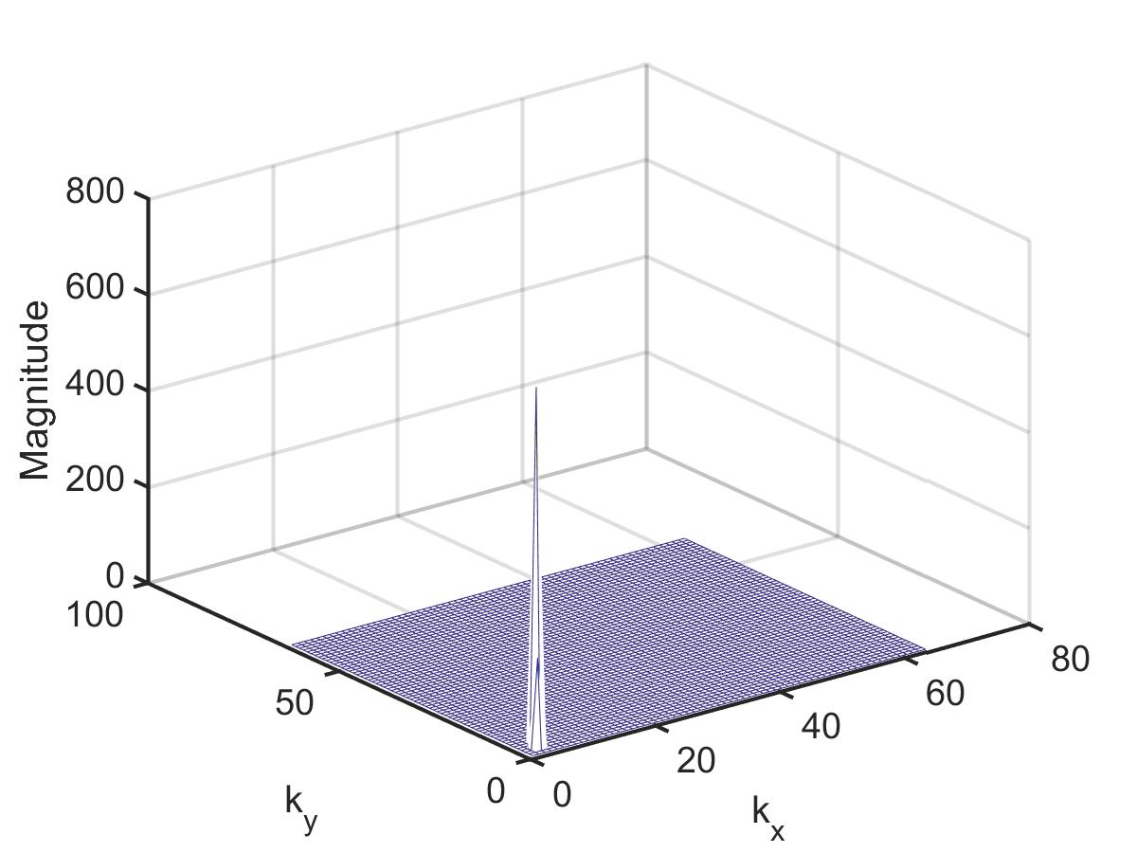
The Total…
Not exactly zero
But considering our initial inputs (~1e16), dramatic reduction in magnitude → Essentially zero

Slide 22

K Space Origin
Eigenvalue solution doesn’t work
1D Exponential not a solution!!
Remember 2D Fourier Space
$C_{i3k3}{\hat{u}}_{k}^{B}=0$
${\hat{u}}_{k=1}^{B}=Ax_{3}+B$
${\hat{u}}_{k=2}^{B}={Cx}_{3}+D$
${\hat{u}}_{k=3}^{B}=Ex_{3}+F$
${δσ}_{i3}^{B}=C_{i3kl}u_{k,l}^{B}$

Slide 23

${δσ}_{i3}^{B}=C_{i3kl}u_{k,l}^{B}=C_{i313}u_{1,1}^{B}+C_{i313}u_{1,2}^{B}+C_{i313}u_{1,3}^{B}+C_{i323}u_{2,1}^{B}+C_{i323}u_{2,2}^{B}+C_{i323}u_{23}^{B}+C_{i333}^{B}u_{3,1}+C_{i333}^{B}u_{3,2}+C_{i333}^{B}u_{3,3}$

Slide 24

Verifying Stress Free Surface
${δσ}_{ij}=C_{ijkl}\left(u_{k,l}−ε_{kl}^{0}\right)$
${δ\hat{σ}}_{ij}=C_{ijkl}\left(iη_{l}{\hat{u}}_{k}−{\hat{ε}}_{kl}^{0}\right)$

Slide 25


${δσ}_{i3}^{B}=C_{i3kl}u_{k,l}^{B}$

Slide 26
Semi-Implicit Fourier Spectral Method
Fourier Transform
Transforms your signal periodically
FFT → discrete, numerical implementation
Derivatives become multiplication → Numerically more stable
Semi-implicit Fourier Spectral Method
Treat the gradient terms implicitly → More stable [LQ Chen]
Can expand the time dependence to get greater time accuracy but at the cost of computational speed
https://en.wikipedia.org/wiki/Linear_multistep_method

Slide 28
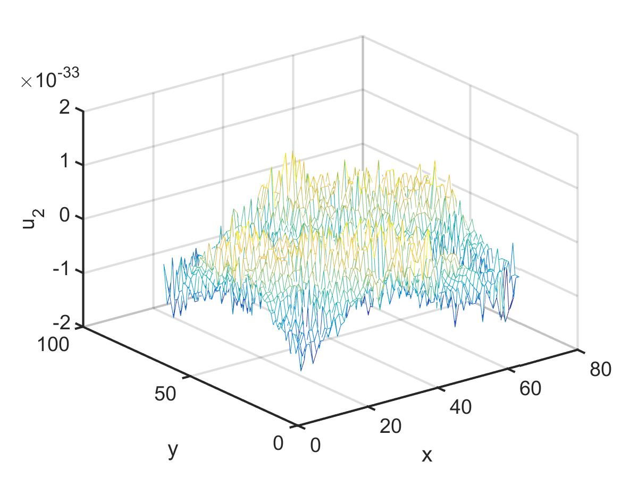
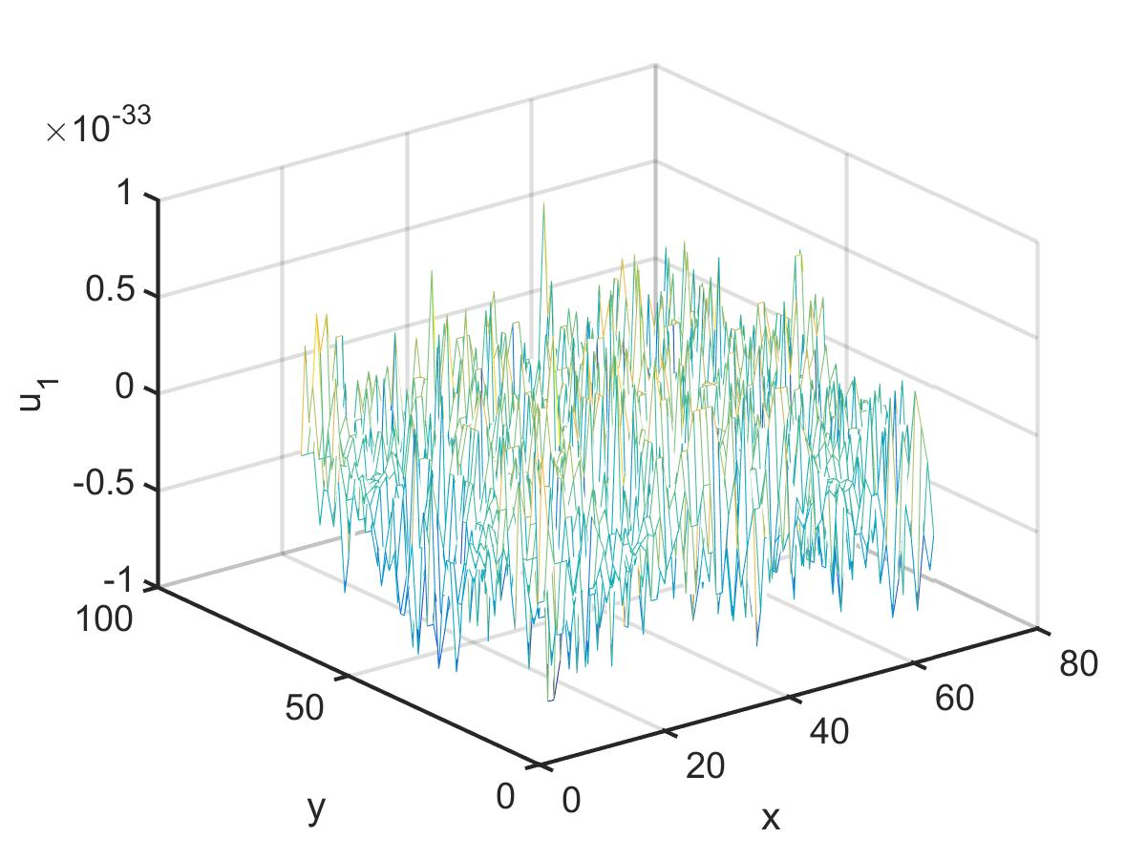
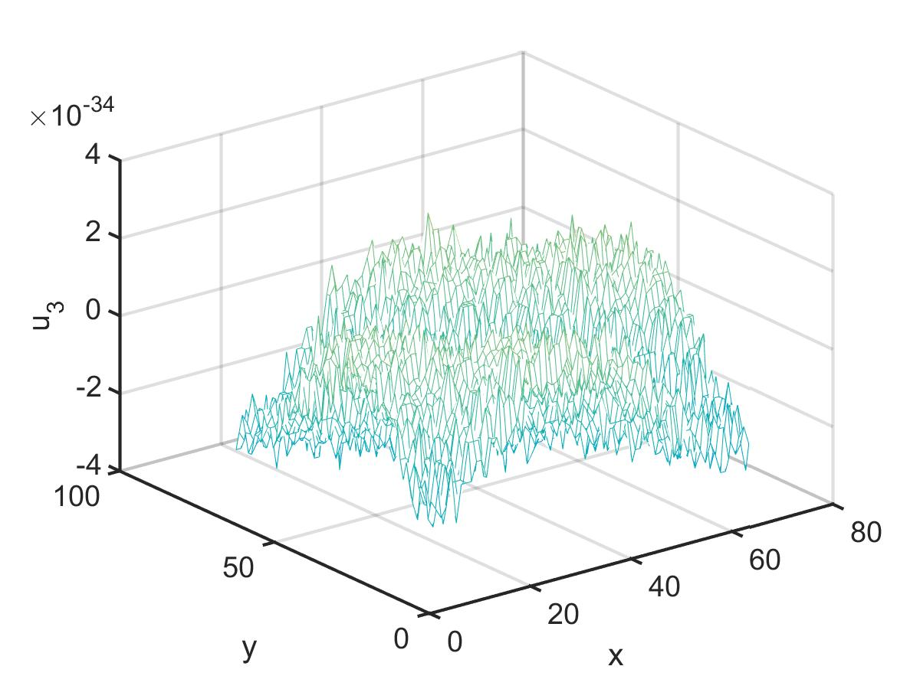
For a Real Case u ~ 0 at substrate

Slide 29
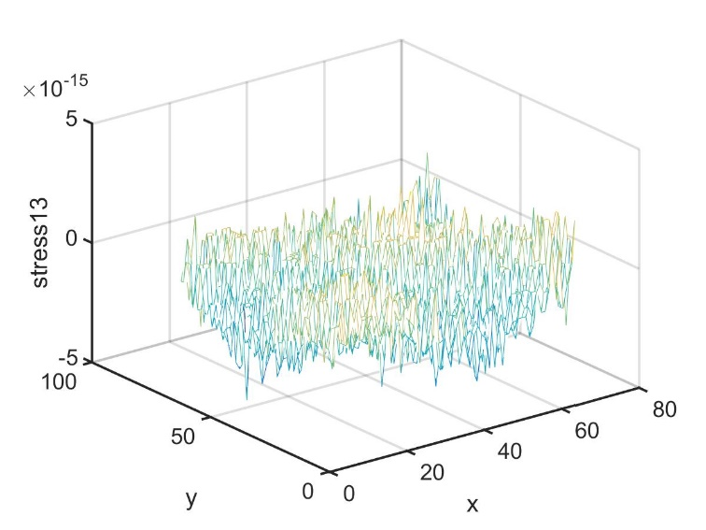
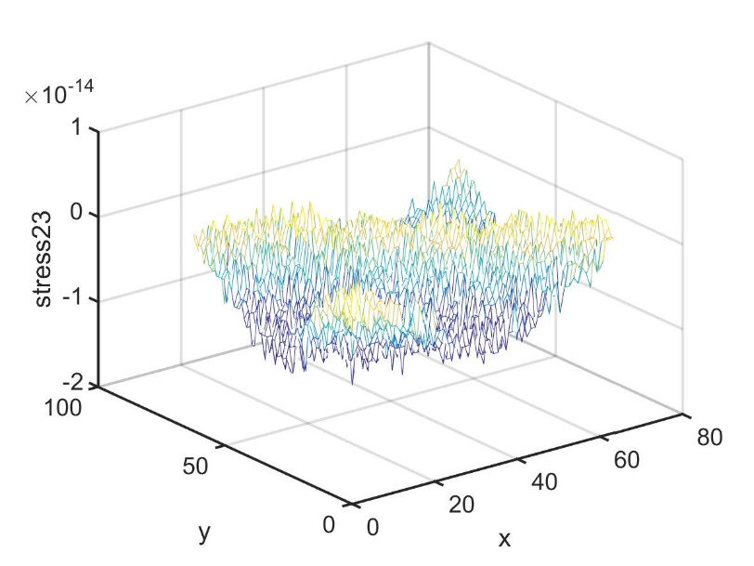
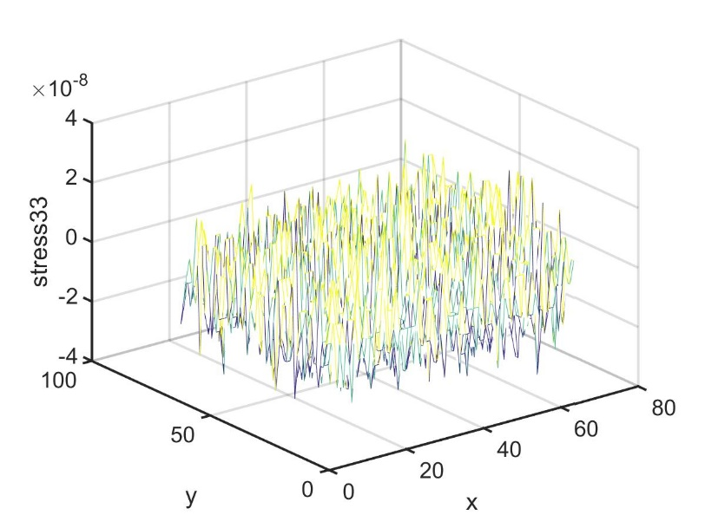
Stress free surface verification

Slide 30
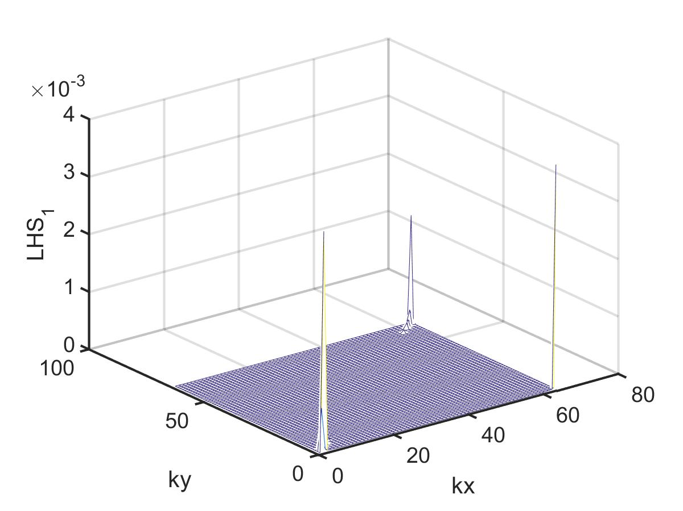
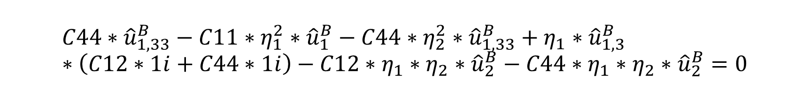
$$C44∗{\hat{u}}_{1,33}^{B}−C11∗η_{1}^{2}∗{\hat{u}}_{1}^{B}−C44∗η_{2}^{2}∗{\hat{u}}_{1,33}^{B}+η_{1}∗{\hat{u}}_{1,3}^{B}∗\left(C12∗1i+C44∗1i\right)−C12∗η_{1}∗η_{2}∗{\hat{u}}_{2}^{B}−C44∗η_{1}∗η_{2}∗{\hat{u}}_{2}^{B}=0$$

Slide 31
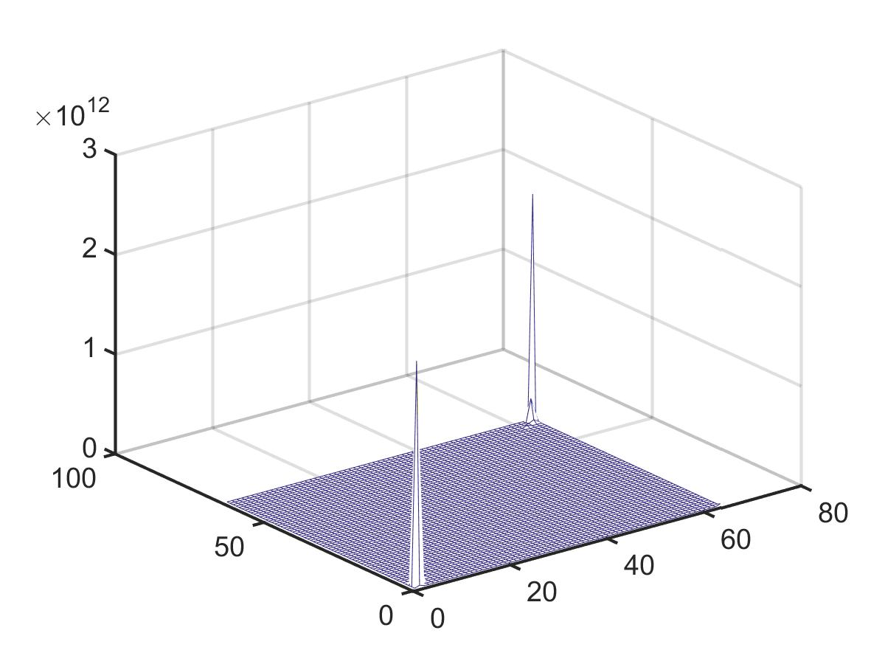

$$C44∗{\hat{u}}_{1,33}^{B}−C11∗η_{1}^{2}∗{\hat{u}}_{1}^{B}−C44∗η_{2}^{2}∗{\hat{u}}_{1,33}^{B}+η_{1}∗{\hat{u}}_{1,3}^{B}∗\left(C12∗1i+C44∗1i\right)−C12∗η_{1}∗η_{2}∗{\hat{u}}_{2}^{B}−C44∗η_{1}∗η_{2}∗{\hat{u}}_{2}^{B}=0$$
x₃ = 0
$$C44∗{\hat{u}}_{1,33}^{B}$$
x₃ = 0
$$C11∗η_{1}^{2}∗{\hat{u}}_{1}^{B}$$
What we are plotting: 2D k-space in plane, constant x₃ cross section, z axis = magnitude of the function value at that specific point

